Slide 1
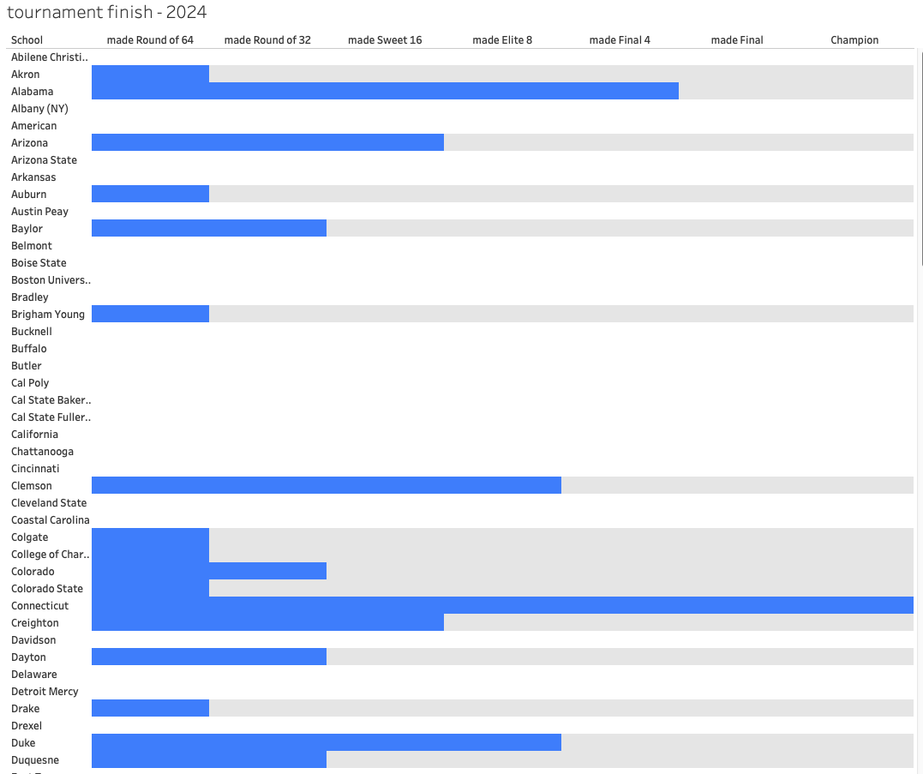
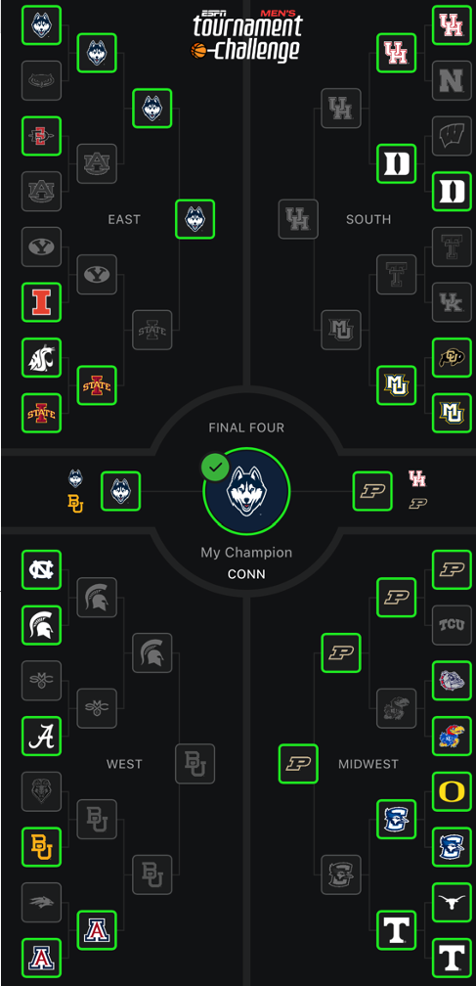
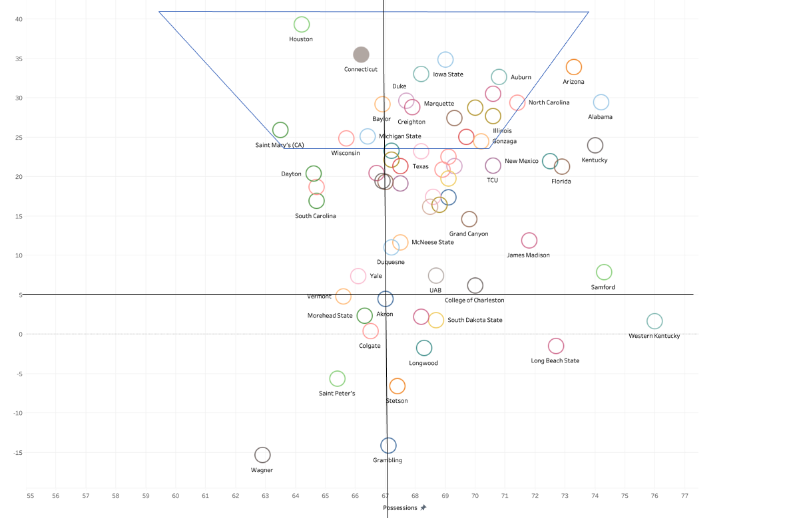
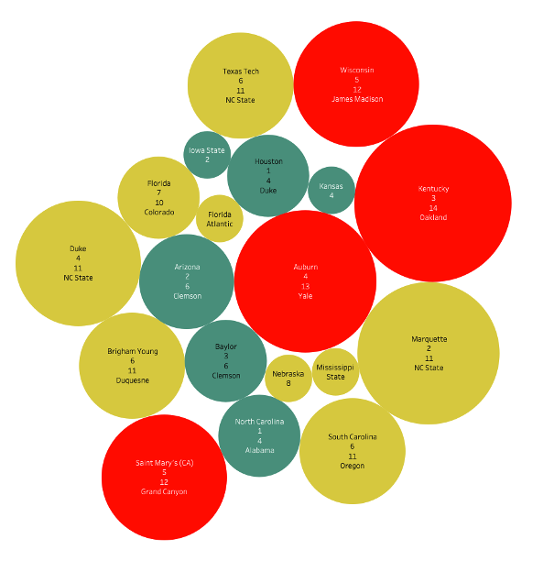

Predicting March Madness
Using the “Trapezoid of Excellence”
Dylan Birzon
Introduction
I’ve always had a passion for sports and analytics and wanted to combine the two. Luckily, I came across a video by Ryan Hammer on TikTok explaining the “trapezoid of excellence”, and how it is used to predict the Final Four teams. My project focused on expanding the reach and use of this method to predict each game from both a visual and model perspective.
The trapezoid graphs teams on a plane based on their possessions and adjusted net rating. Those that fall in the trapezoid tend to have a higher chance of making it into the Final Four
Data Analysis
We’ll start by understanding how Possessions and Net Rating impact each other. Teams that have higher efficiencies typically lean to be more efficient per possession and/or are really good defensively (Houston). Teams that play faster don’t necessarily rely on a basket-by-basket approach, but rather by volume. For example, Alabama has a high volume of 3-pointers shot.
Usually, teams that have average possessions are adaptable to game speed depending on their opponent. Combine that with high efficiency, and in theory, that’s a team making it to the final four.
Analyzing these metrics against opponents presents an opportunity to predict a winner and potential upsets. If a fast team plays a slow team, either the team can’t keep up with the speed, or the game is slowed down too much that the team’s lack of efficiency doesn’t get the volume to score points. (Saint Mary’s vs Grand Canyon).
Conclusion
While there have been successful predictions, this cannot be relied on solely to predict the outcome of every game. Other factors need to be considered like age of players to help with urgency to win, or nerves being settled, coach experience, injuries, if they played OT the previous game, etc.
Freak things happen every year. This year was NC State making it into the Final Four, and Oakland’s win over Kentucky.
It’s next to impossible to get a perfect bracket, but this allows us to get a better insight on how to ”guess” these games
Results
39/64 games predicted correctly → 60.9375%
Predicted the championship game and winner correctly
Didn’t consider Kansas point guard was out against Gonzaga, hence the wrong pick
3/11 correct upsets predicted (first round only) → 27.27%
3/11 wrong upsets predicted (first round only) → 27.27%
8/11 upsets not predicted (first round only) → 72.72%
Methods
Using the adjusted net rating and possessions from SportsReference for all 64 NCAA tournament teams since the 2011 tournament, I preprocessed the data in Excel to allow Tableau to read the data properly. I will use the same Excel sheet to track each matchup and outcome to feed it into my model (as of writing this April 18th)
Predictor 1: Adjusted Net Rating
This measure examines the difference between Offensive and Defensive Efficiency (points for and points against)
Need to look at an adjusted value because it factors in Strength of Schedule – a team’s average schedule difficulty, opponent’s rating, and game location
Predictor 2: Possession
This is tempo – how fast do teams play? This considers how fast teams play on offense, and how many turnovers they force on defense
Average possessions are between 60 and 80
55 or less is slow, 90 or more is fast
MS Business Analytics
Jacobs School of Management
buffalo.edu

